Slide 1

Cricket – The Baseball of Former British Colonies
Andrew Odnoralov

Slide 2
What is Coming Up
Slides 1 & 2: 2019 Cricket World Cup Rate Stats Batting and Bowling
Emphasis on Batter Strike Rate (runs scored per 100 balls – like wOBA) and Bowler Economy (Runs per Over of 6 balls bowled – Like ERA) – also will be emphasis on this throughout whole presentation
Slides 3 – 7: 2022 T20 Vitality Blast Batting and Bowling: Player, Team and Standings
Bowlers: Wickets (outs earned), 4W/5W (# of games with 4 and 5 wickets), Maidens (Over with 0 runs – like immaculate inning), Econ
Batters: 4s and 6s (boundary hits worth 4 and 6 runs – like ground-rule double and home run), Half-Centuries (50 runs in a game – big day), Centuries (100 runs in a game – huge day), Batter SR
Slides 8 – 9: Indian Premier League Batting and Bowling Career Logs and Dot Percentage
Batting: Jos Buttler – Dot% (percent of balls where 0 is scored), Batter SR, and career 6s Waterfall Chart | Bowling: Rashid Khan – Dot% (percent of balls where 0 is given up), Pitcher Economy, and career Wickets Waterfall Chart
Slide 10: 2019 Indian Premier League Rajasthan Royals Salaries and Value
Includes Wins Above Average – like WAR but compares to average player instead of replacement level player – Explanation and formula Here at CricMetric
Salary data to show drastic wealth gap and broken system (10 years of team control and player auction)
Slide 11: Advanced Metrics – Adjusted Batter Strike Rate and Bowler Economy
Rewards Bowlers for Bowling Wickets and Punishes Batters for Giving Wickets – Based on Run Expectancy (prototype xwOBA?) Links: Here and Here
Slide 12: Summary and Links to White Ball Analytics Data
Tableau Database up to 2018 of True Rates which adjust for Powerplays (limit on fielder alignment period), Park Factors, and relative to Australian League (Big Bash)

Slide 3
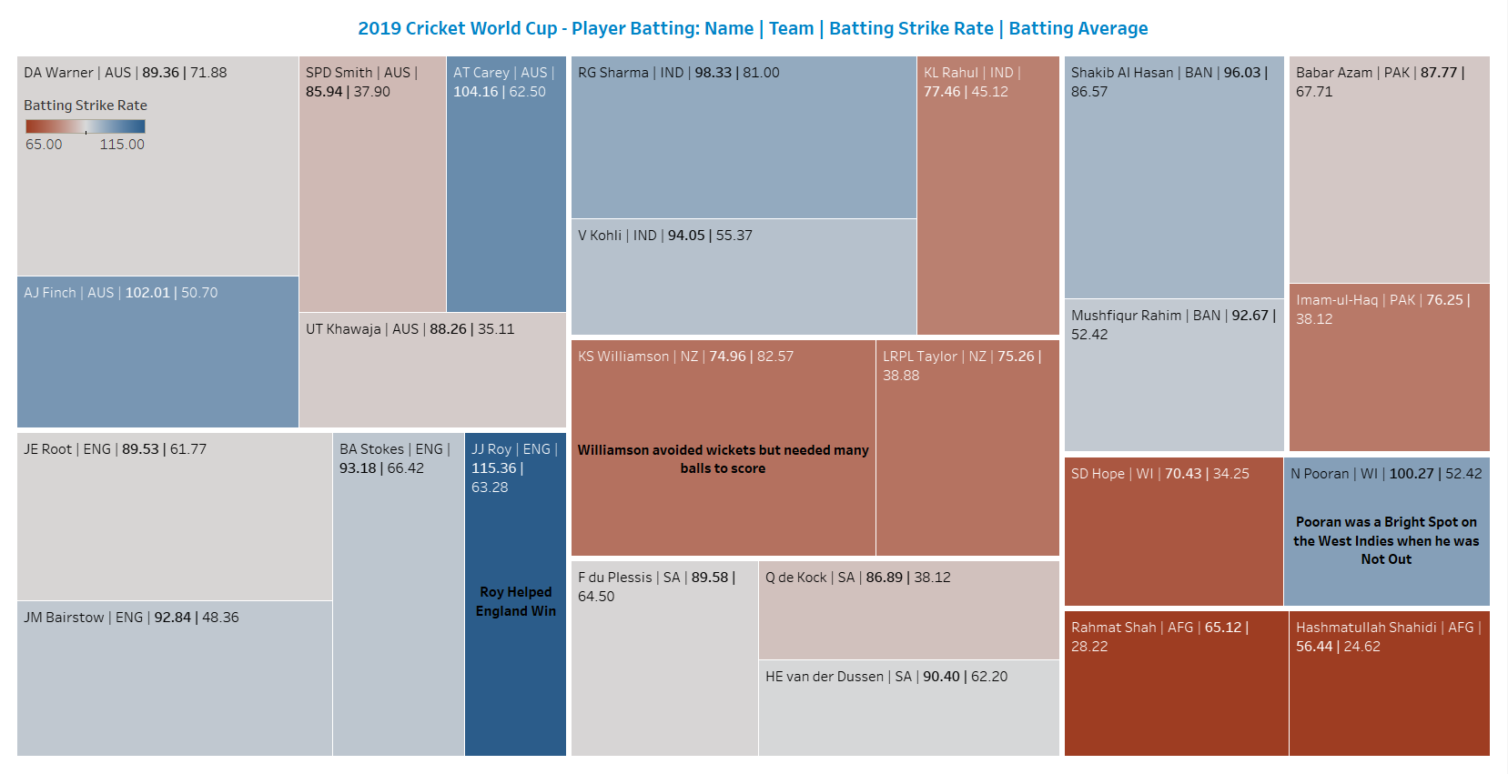

International Intro to Batting Rate-Stats (size represents balls faced)

Slide 4
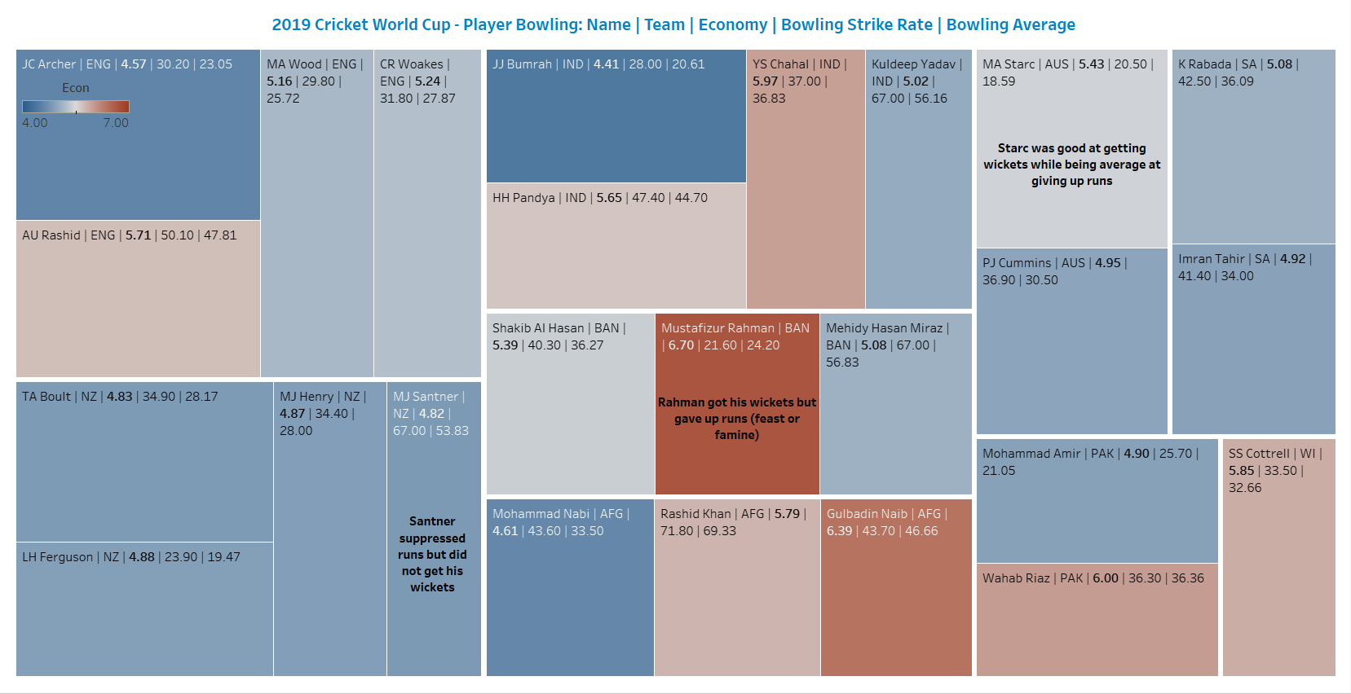

International Intro to Bowling Rate-Stats (size represents overs)

Slide 5
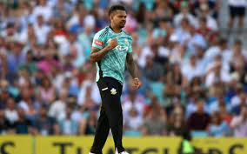

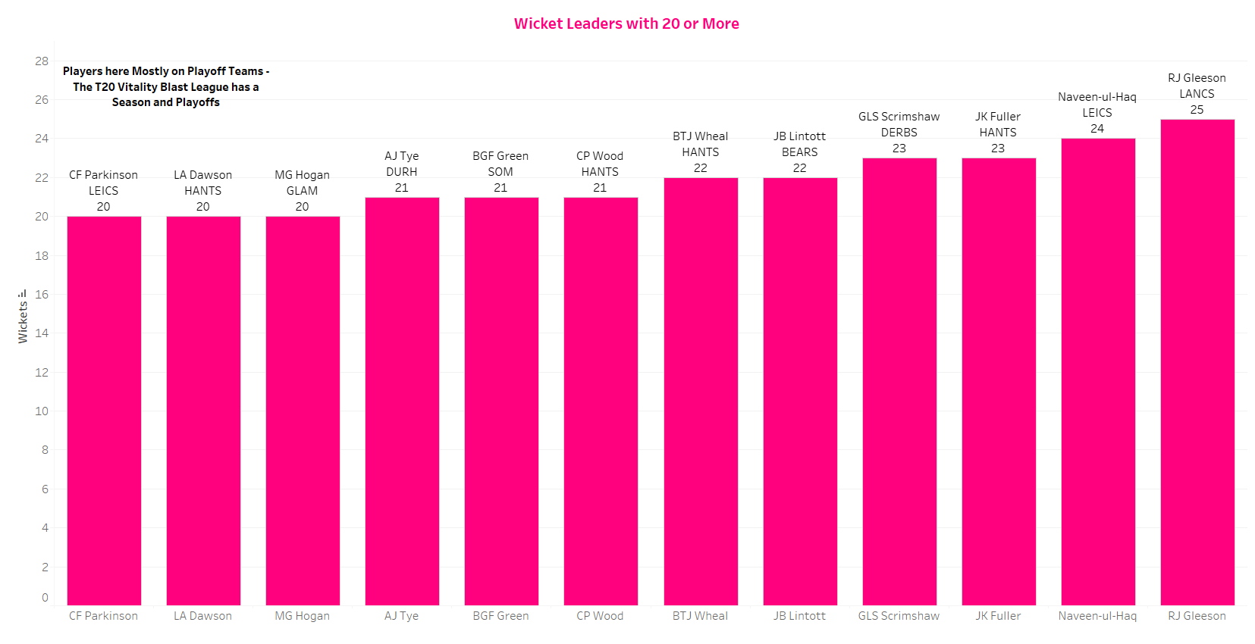
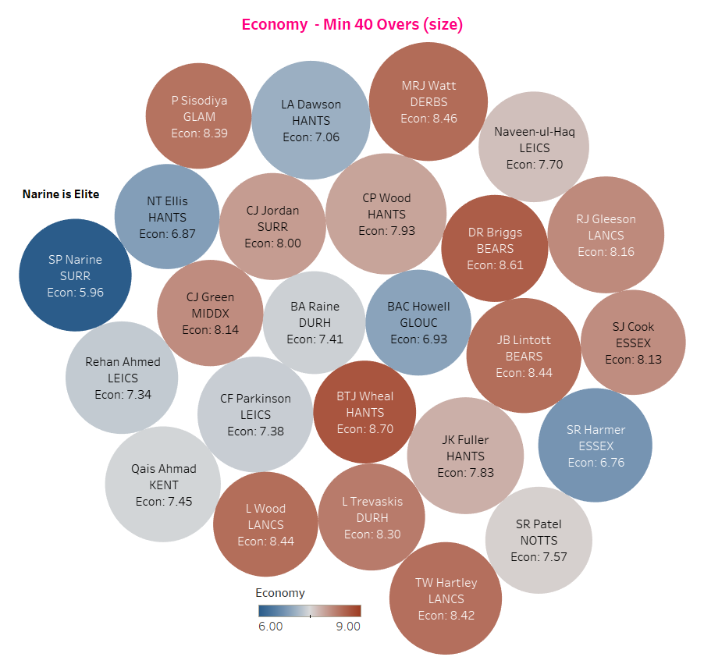
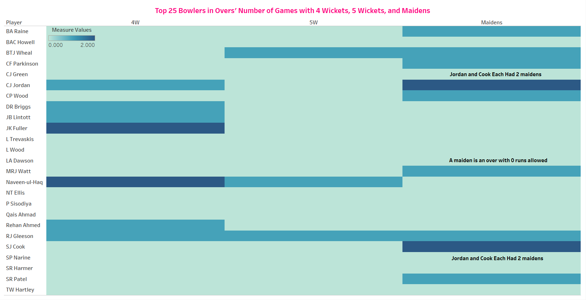
2022 T20 Vitality Player Bowling

Slide 6
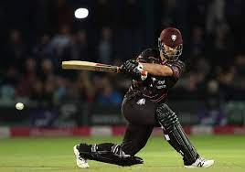
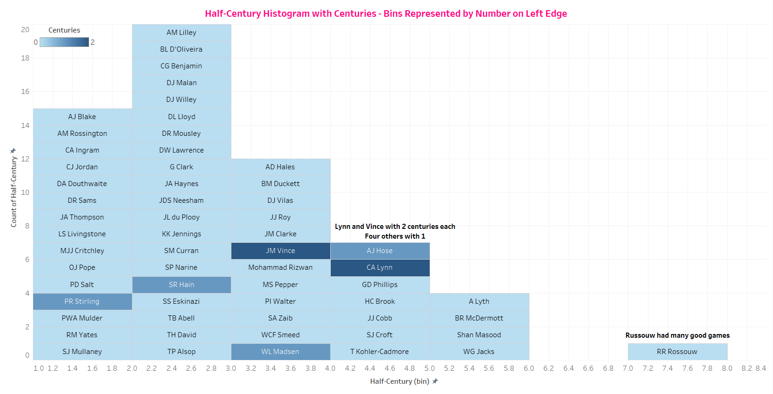
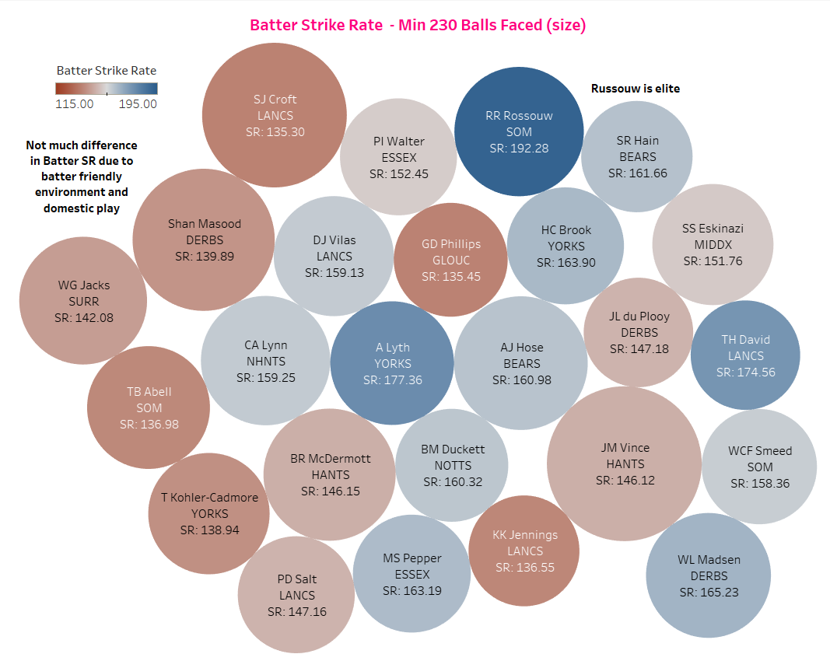
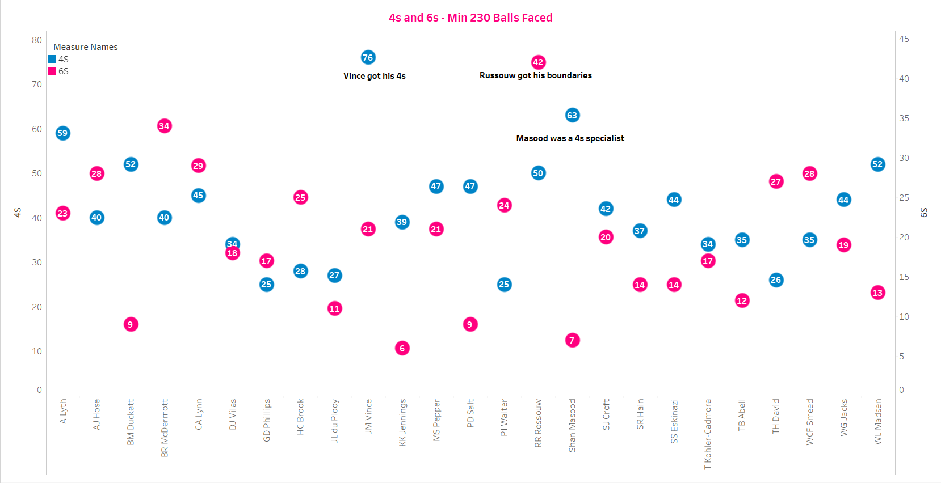
2022 T20 Vitality Player Batting (the Rossouw slide)

Slide 7
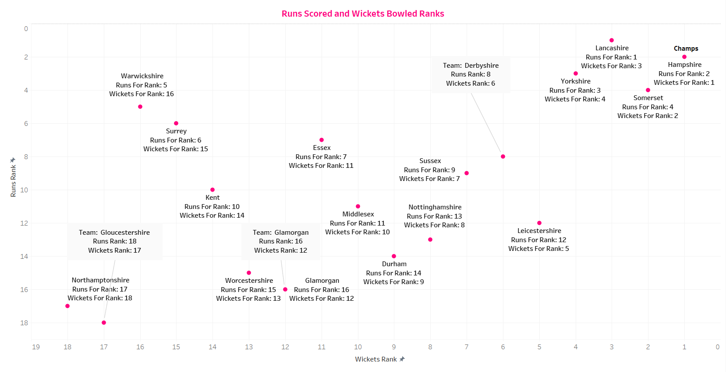
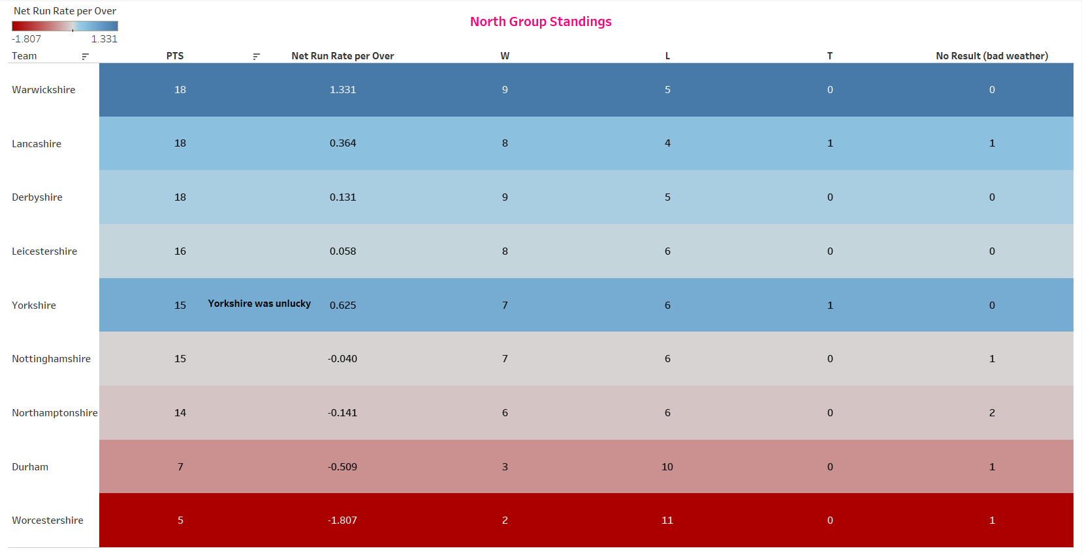
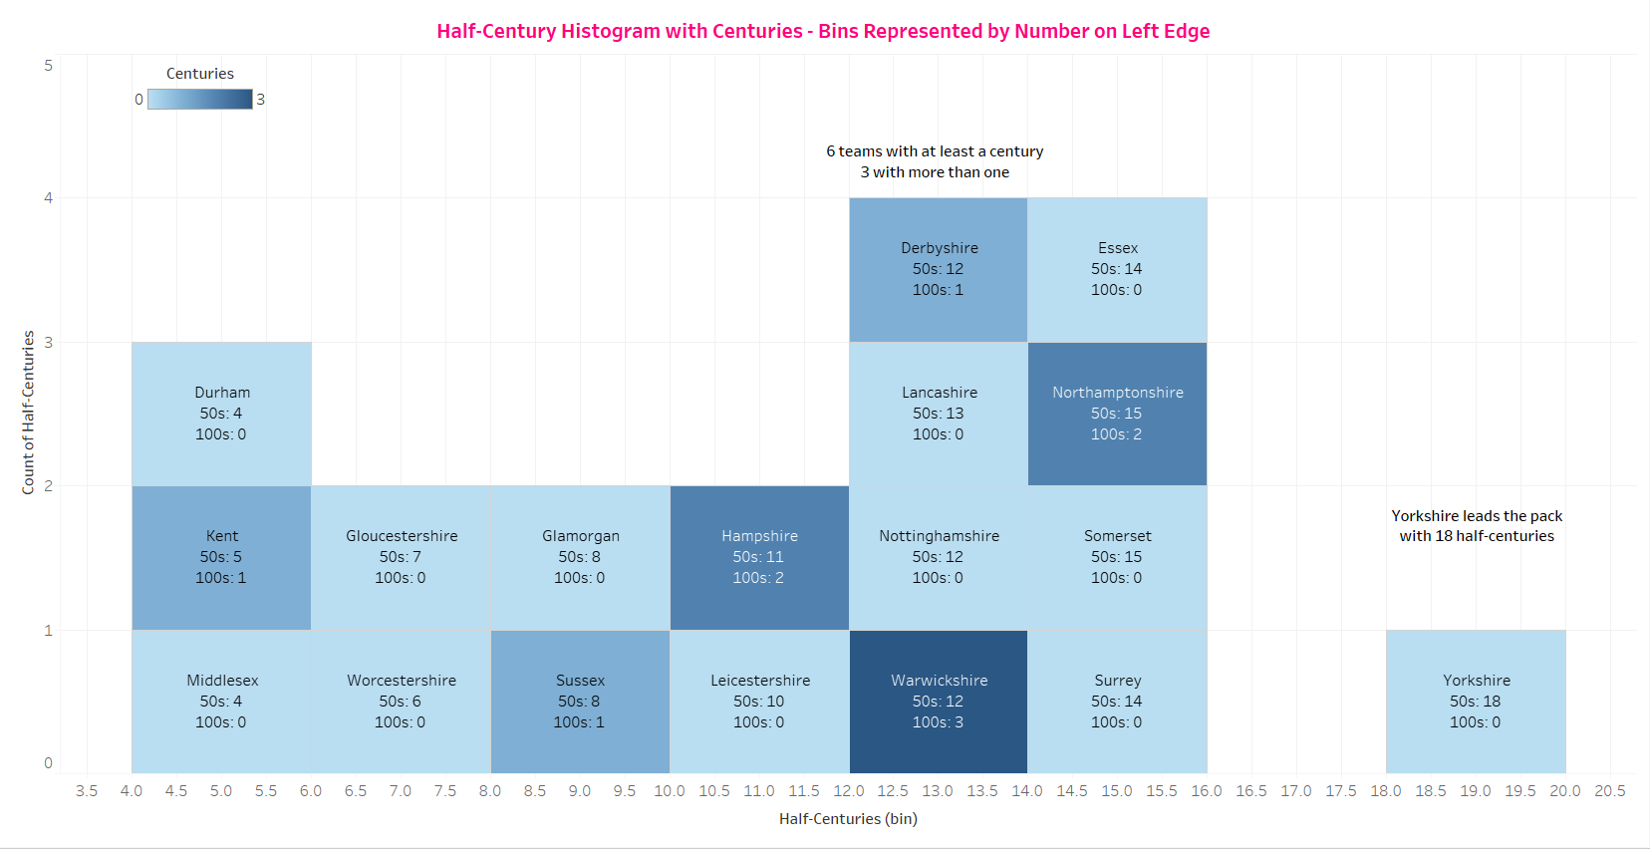
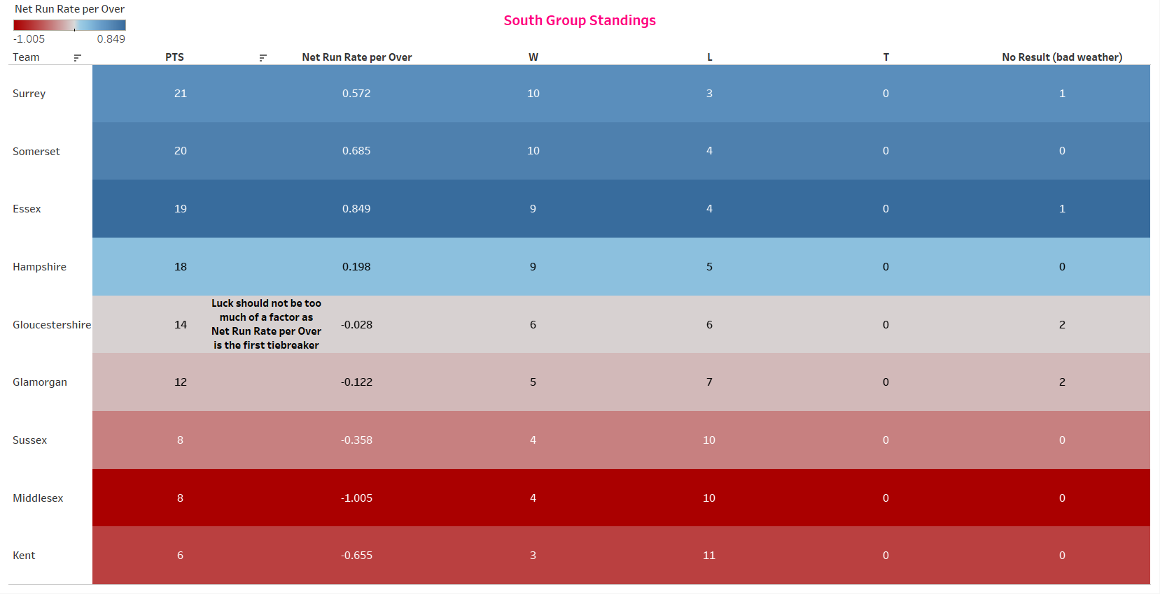

2022 T20 Vitality Team Stats and Standings

Slide 8
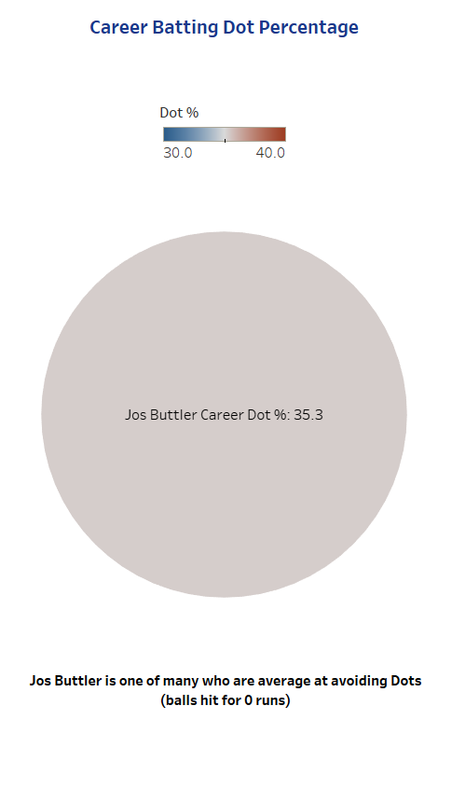

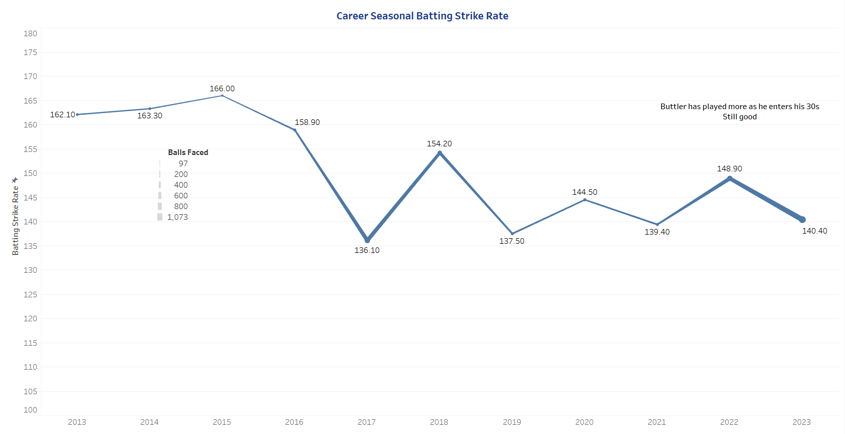
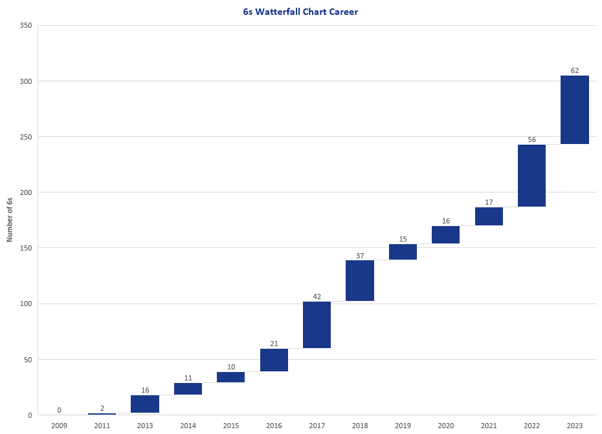
Jos Buttler Career and Seasonal Batting

Slide 9
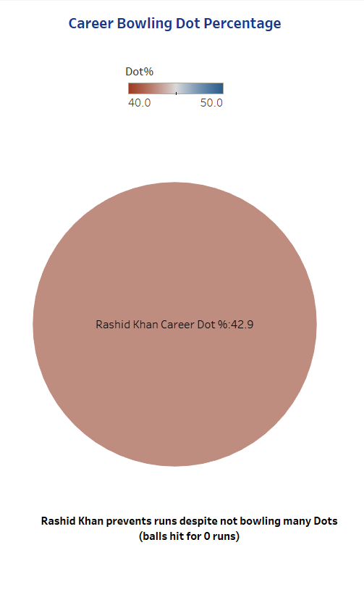
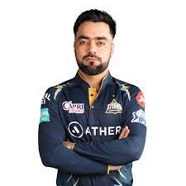
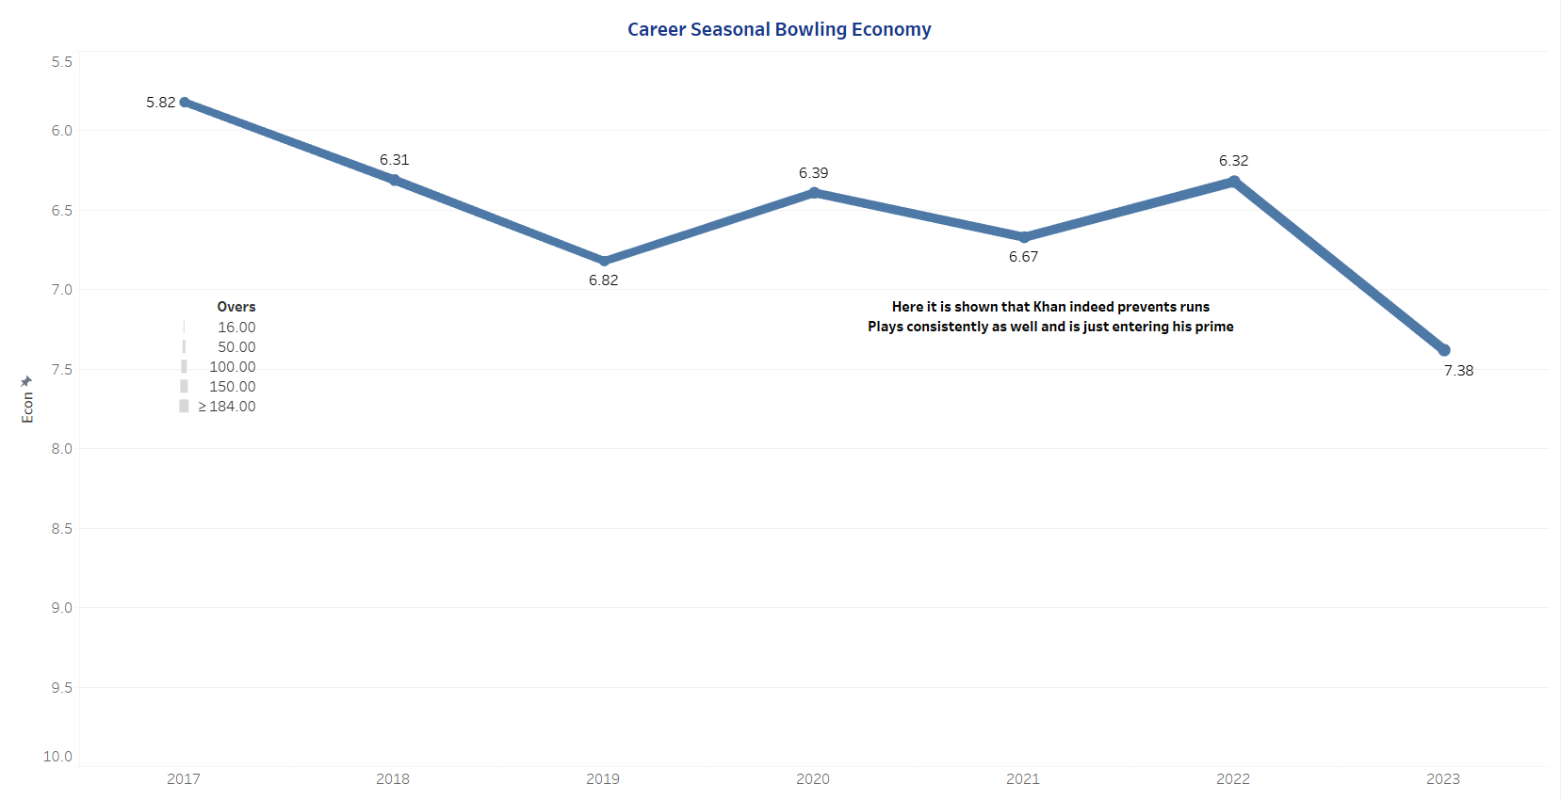
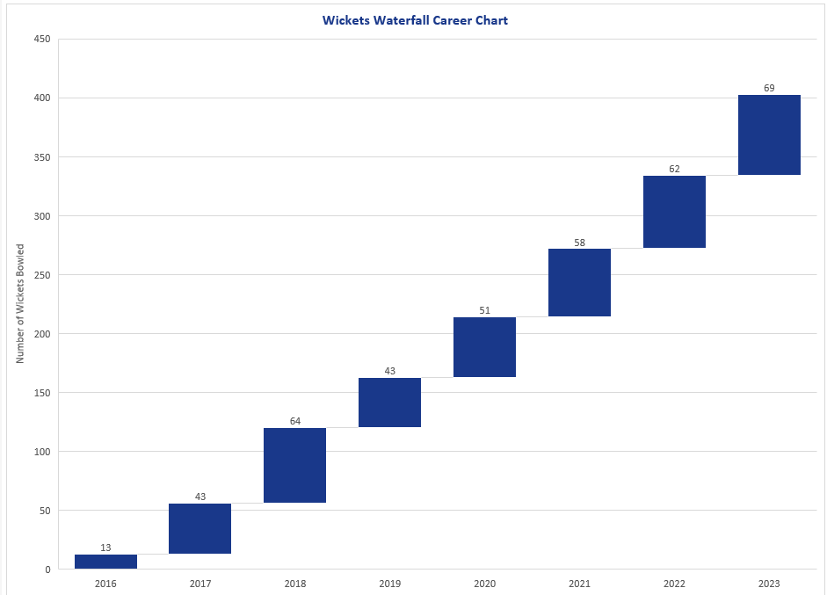
Rashid Khan Career and Seasonal Bowling

Slide 10
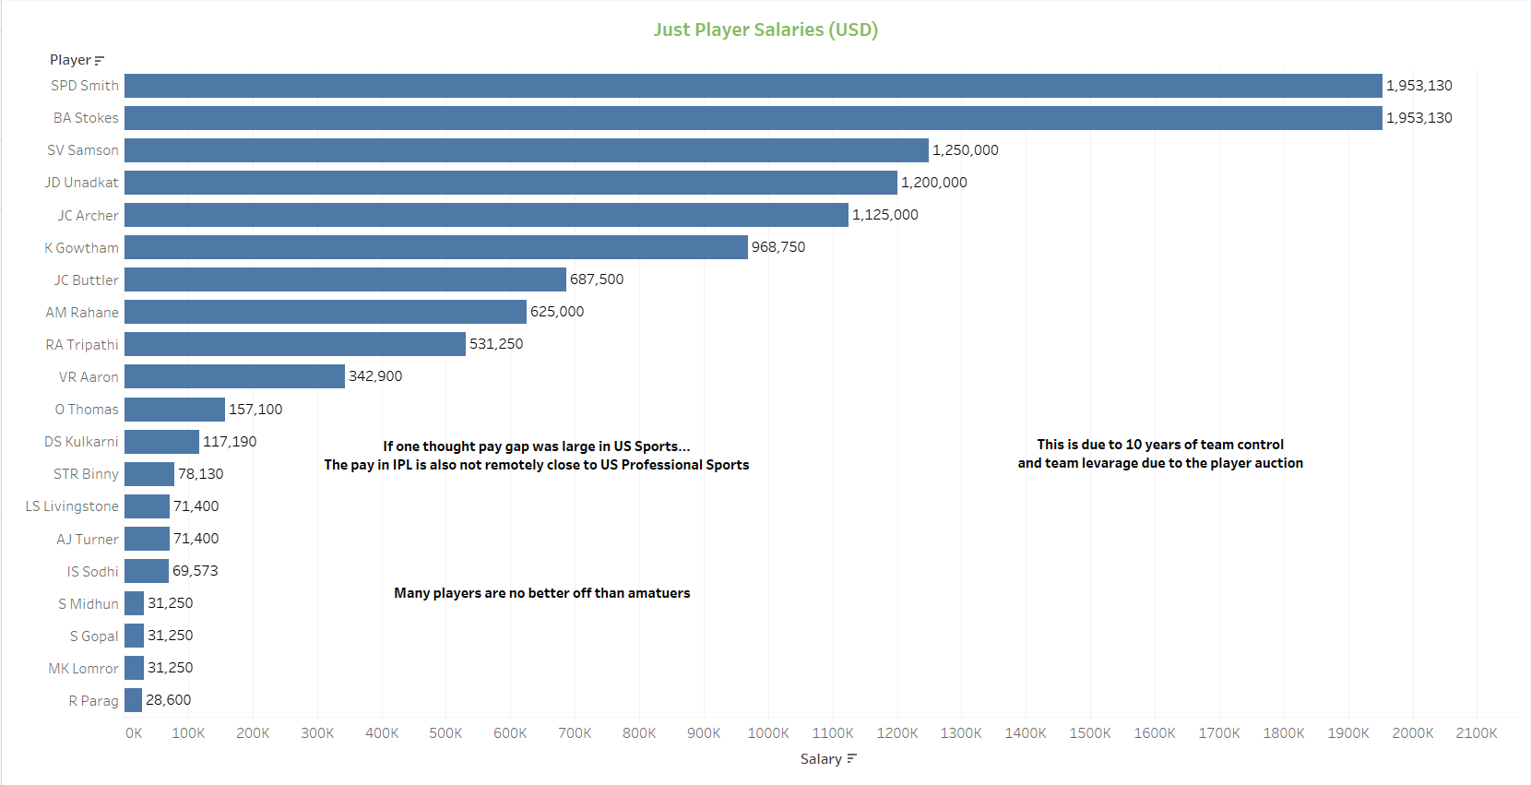

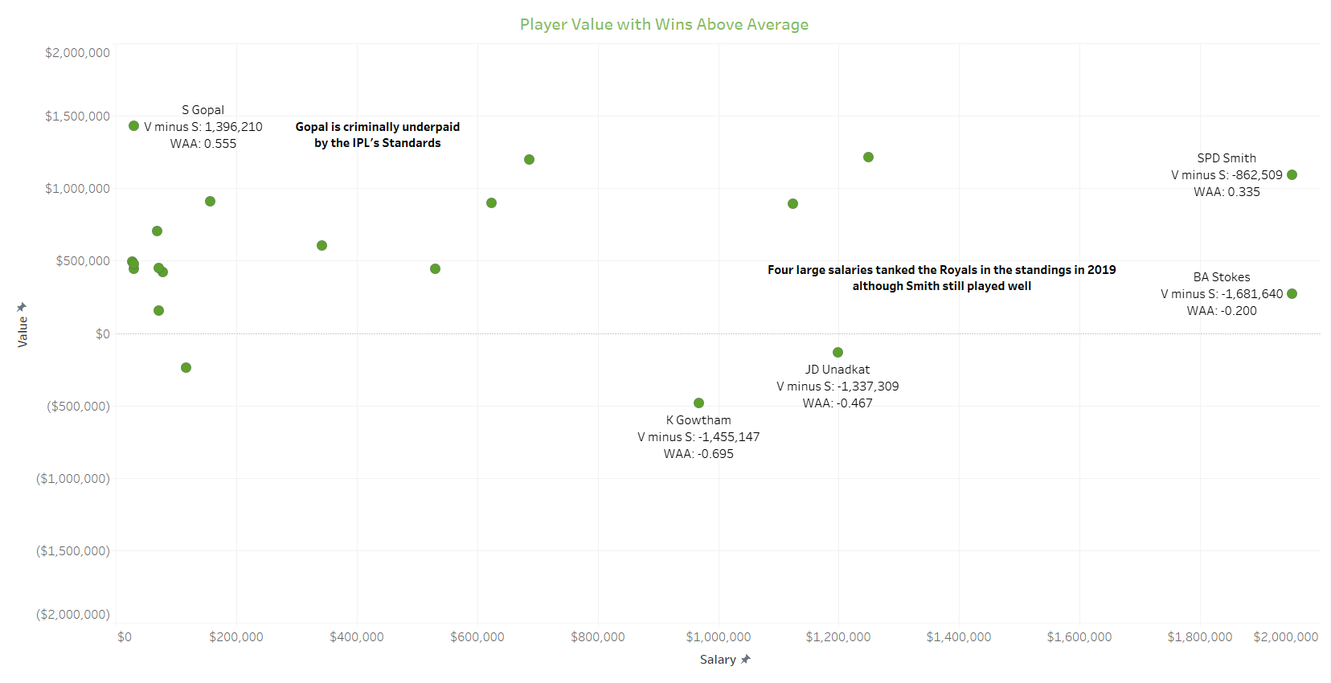
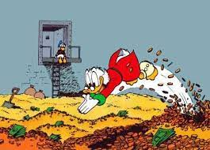
2019 Indian Premier League’s Rajasthan Royals Value and Salary

Slide 11

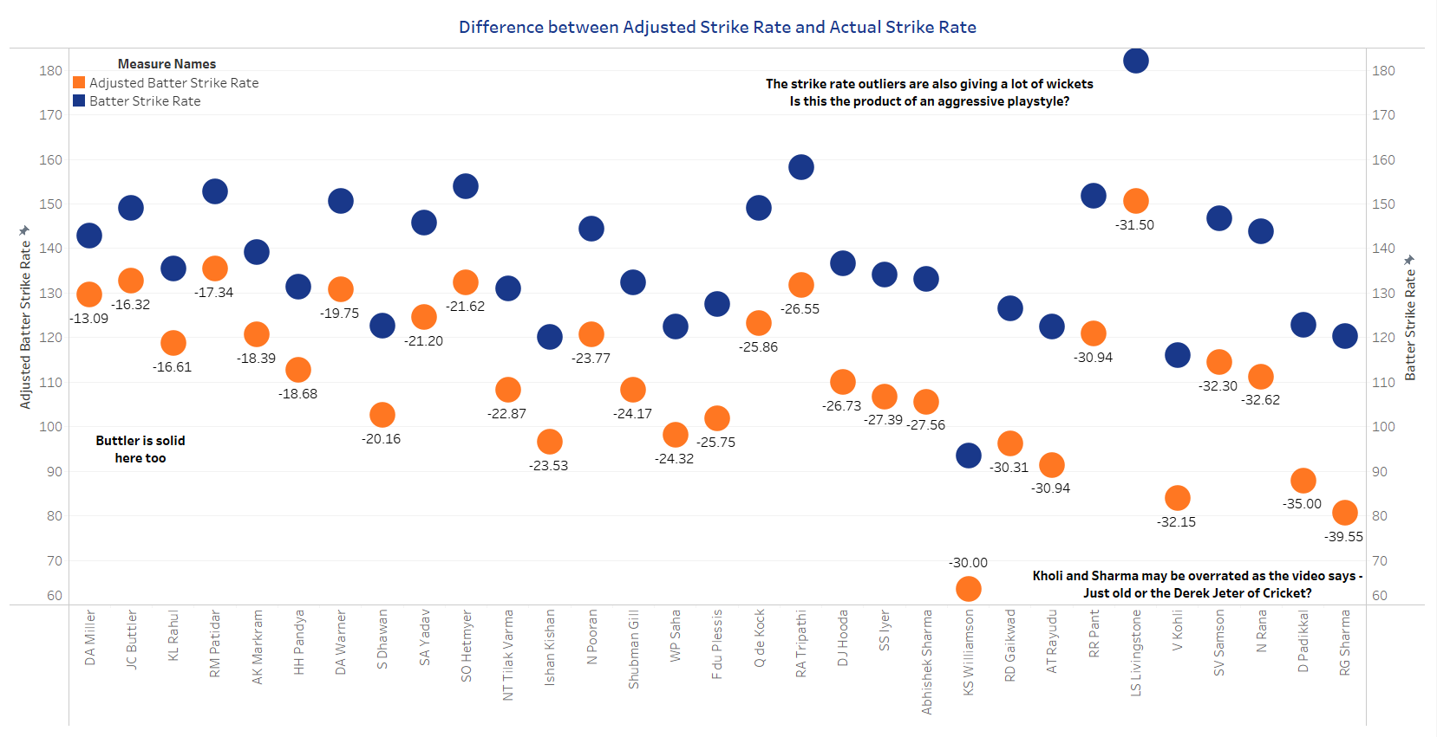
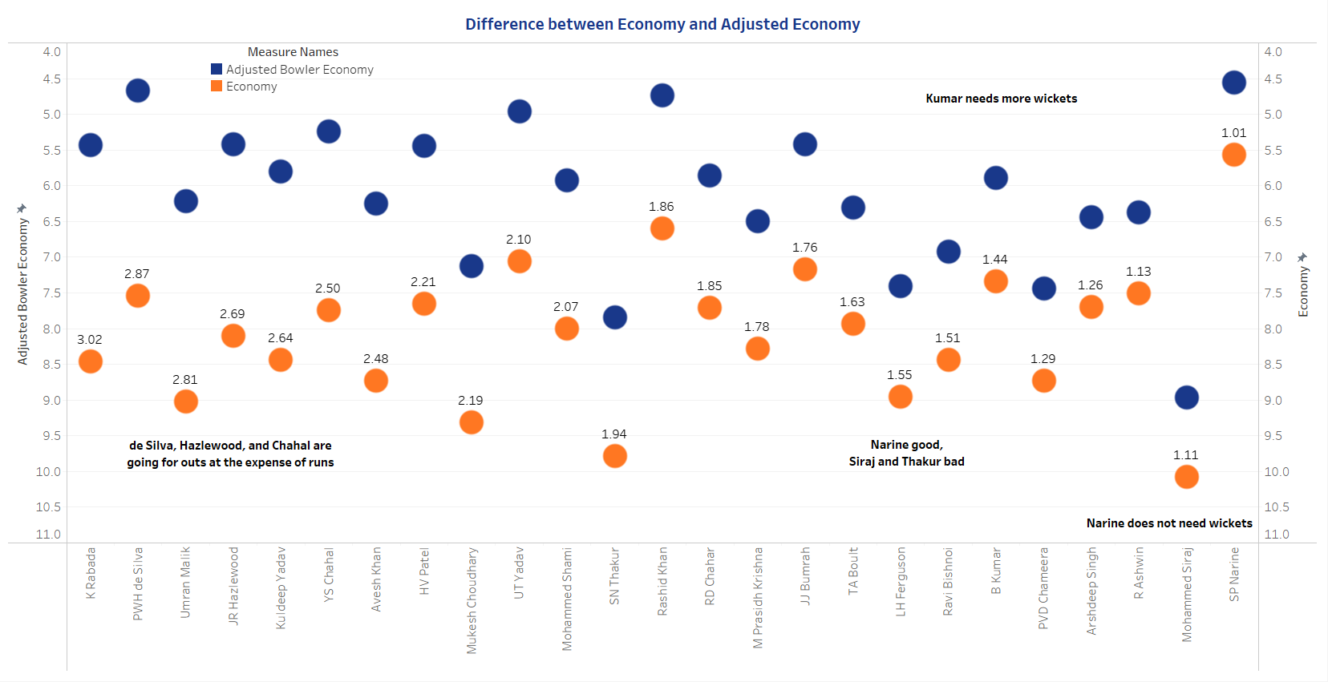
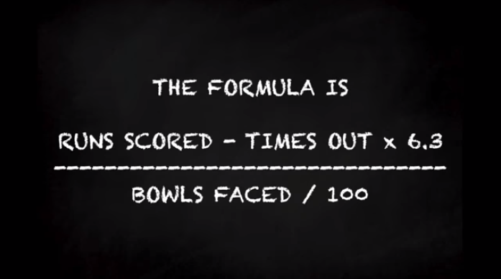
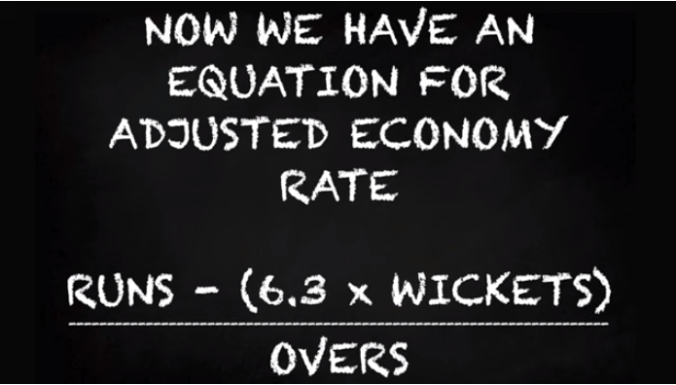
Indian Premier League Advanced – Adjusted Batter Strike Rate and Bowler Economy

Slide 12
Summary and White Ball
Did not feel the need to include Test Cricket as primary metrics were covered – wanted to cover salary and advanced metrics
Cricket needs player tracking and more public models
Income Inequality is afoot in the IPL
Jos Buttler is a good batter who has settled into his own – avoids outs and produces
Rashid Khan is consistently healthy and is a steady bowler
Narine Plays well in both the UK and India
Maybe adjusted rates can indicate an aggressive or passive playstyle
Links to White Ball Tableau Files: True Batting and True Bowling

